Slide 1
Bulkley Timber Supply Review (TSR4) Update
BULKLEY TSA STEERING COMMITTEE MEETING
October 25th, 2022

Slide 2
Purpose Recap
The purpose of a Timber Supply Review (TSR) is to gather and present information to the chief forester to advise the AAC determination. It is a multi-step process that involves:
The release of a Data Package that describes known information and current management
A timber supply analysis that is based on the Data Package
The release of a Public Discussion Paper that outlines the results of the analysis
The presentation of a summary of all technical, First Nations engagement and consultation, and public review information to the chief forester
The chief forester’s AAC determination and AAC Rationale release

Slide 3
Process Update
Bulkley TSR4:
Underway since November 30, 2021. Legislated deadline for new AAC is January 29, 2024
Being run in parallel with Morice TSR using services of the same FAIB analyst
<show process timelines, previous and revised, highlight increased alignment of Bulkley and Morice TSR processes>
Bulkley TSR4 is in the “Information Sharing and Gathering” phase. Significant time (District/ FAIB at this stage) has been spent in:
  Assembling the spatial data library - SSAF ESI layers, BCGW layers, District- and Region-derived layers, etc.
  Building out a rough draft Data Package to support Collaborative Engagement

Slide 4
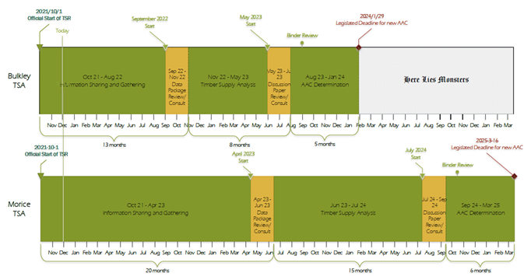
Original Timeline

Slide 5
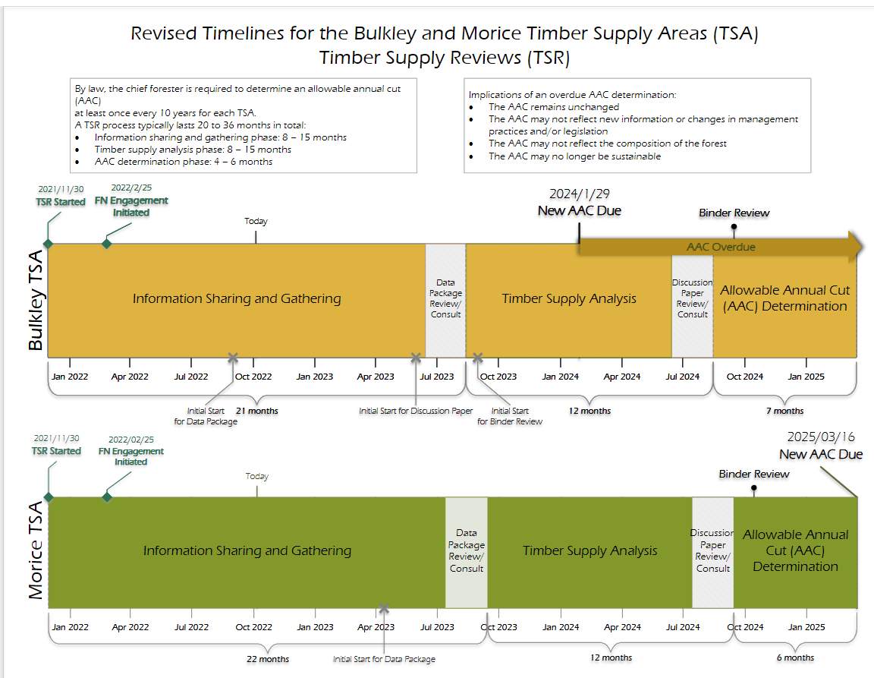

Slide 6
Collaborative Engagement
Per provisions in the Recognition and Reconciliation of Rights Policy for the BC Treaty Process, and DRIPA, the Province has committed to recognize and collaboratively implement s. 35 Rights.
BC’s Chief Forester has committed to a framework for AAC decision-making that (e.g.):
aligns with existing FN/ BC agreements
integrates a collaborative approach that goes beyond normal consultation to meaningfully advance reconciliation
provides a transparent understanding of AAC decision-making.
ensures AAC’s are sustainable and do not adversely affect FN ability to exercise s. 35 Rights.
During summer 2022 work progressed on bringing together a single-table Collaborative Bulkley and Morice Timber Supply Review Working Group (CTWG), expected to operate under the following engagement model <summarize its features>
CWTG engagement is expected to begin November 2022

Slide 7
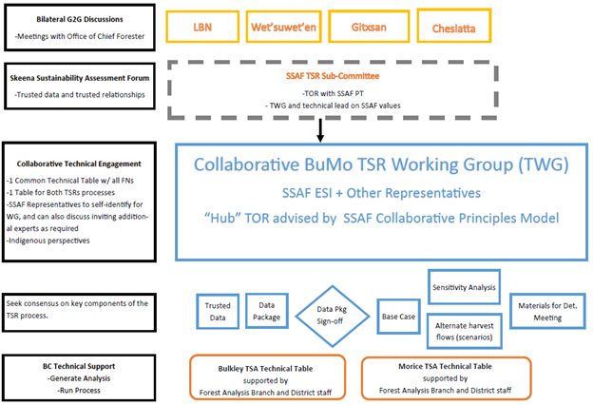
Collaborative Engagement Model

Slide 8
CTWG objectives
(still being finalized)
Data Package
identify “best available” and “trusted” data inputs
identify and where possible work to fill data gaps
discuss and confirm base case modelling assumptions
strive to reach consensus on Data Package contents
strive to reach consensus on the base case timber supply forecast projection
collaborate on the design of sensitivity analyses
Public Discussion Paper (PDP)
co-develop PDP format
strive to reach consensus on key points
provide indigenous perspectives to be included in PDP sections
Recommendations to the Chief Forester
develop and present recommendations and decision materials to the chief forester
strive to reach consensus on matters that have implications on Section 35 Rights and other interests.

Slide 9
Role of
SSAF TSR SubCommittee
Provide technical expertise and leadership in CTWG engagement on SSAF ESI’s primary values: grizzly, moose, fish & fish habitat, wetlands, and medicinal plants.
Spearhead integration of SSAF trusted data and cultural indicators work into the TSR process
Share/distribute SSAF PT endorsed material required for the work of the CTWG, including trusted data and documents
Facilitate discussion and joint problem solving

Slide 10
A Few Contacts:
 | Role | Contact Email
Collaborative BuMoCTWG | Co-Chair – April Bilawchuk (Team Lead, Indigenous Engagement) Co-Chair - Glen Buhr (TA/Regional Monitoring Specialist) FN Co-Chair – To Be Determined | April.Bilawchuk@gov.bc.ca Glen.Buhr@gov.bc.ca TBD
SSAF ESI/ TSR Integration | Leigh-Ann Fenwick (Director, Strategic Initiatives) | Leigh-Ann.Fenwick@gov.bc.ca
Office of Chief Forester | Project Manager – Agathe Bernard (TSR Forester) Analyst – David Stuart (Timber Supply Forester) | Agathe.Bernard@gov.bc.ca David.Stuart@gov.bc.ca
District TSR Teams | DSS Lead - Jen Plummer (A/Stewardship Officer) DND Lead – Devin Dake (Stewardship Officer) | Jennifer.Plummer@gov.bc.ca Devin.Dake@gov.bc.ca
Collaborative BuMoCWG | Co-Chair – April Bilawchuk (Team Lead, Indigenous Engagement) Co-Chair - Glen Buhr (TA/Regional Monitoring Specialist) FN Co-Chair – To Be Determined | April.Bilawchuk@gov.bc.ca Glen.Buhr@gov.bc.ca TBD
SSAF ESI/ TSR Integration | Leigh-Ann Fenwick (Director, Strategic Initiatives) | Leigh-Ann.Fenwick@gov.bc.ca
Office of Chief Forester | Project Manager – Agathe Bernard (TSR Forester) Analyst – David Stuart (Timber Supply Forester) | Agathe.Bernard@gov.bc.ca David.Stuart@gov.bc.ca
District TSR Teams | DSS Lead - Jen Plummer (A/Stewardship Officer) DND Lead – Devin Dake (Stewardship Officer) | Jennifer.Plummer@gov.bc.ca Devin.Dake@gov.bc.ca

